Slide 1
SMART EVENT INFRASTRUCTURE
AI-Powered Fest Attendance & Crowd Management
Know who is there. Know where they are. Act before it becomes an emergency.
te

Slide 2

THE CHALLENGE
Current methods face critical safety blind spots.
Slow manual entry.
Creates massive queues and bottlenecks.
Unknown crowd size.
Organizers lack real-time attendance data.
Reactive security.
Alerts arrive only after incidents occur.

Slide 3

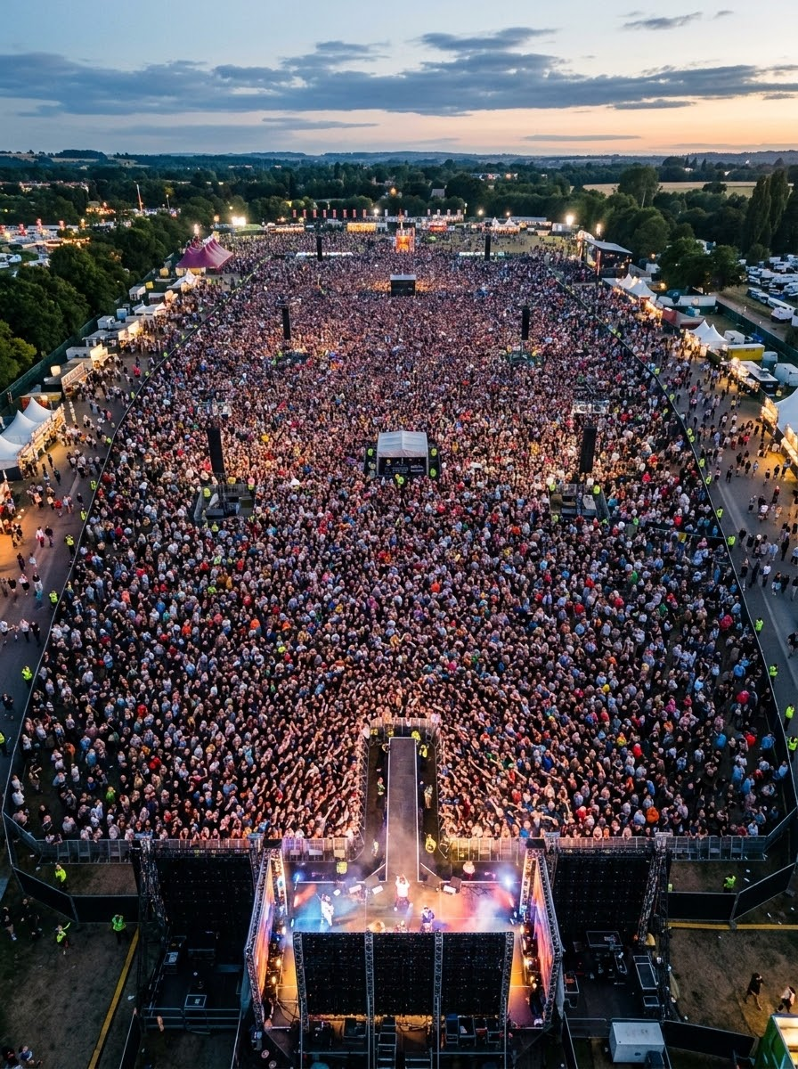
PROBLEM STATEMENT
Managing thousands of festival attendees creates severe operational bottlenecks.
Manual Bottlenecks
Traditional pen-and-paper or basic check-ins are extremely time-consuming, driving massive gate queues.
Unauthorized Entry
Overcrowding and unverified credentials allow fake IDs and untracked guests to breach security zones.
Sudden Crowd Surges
Unpredictable attendee movements and panic surges leave organizers blind without real-time data.
Missing Persons
Locating lost students, staff, or guests in massive crowds becomes near impossible without spatial tracking.

Slide 4




MULTI-LAYER SECURITY
AI Identity Verification Flow
Secondary biometrics catch suspicious ID usage.
1. QR Scan
2. DB Verification
3. AI Face Match
4. Entry Granted
Initial gate authentication.
Cross-check registration.
Prevents ID sharing.
Automated logging.

Slide 5
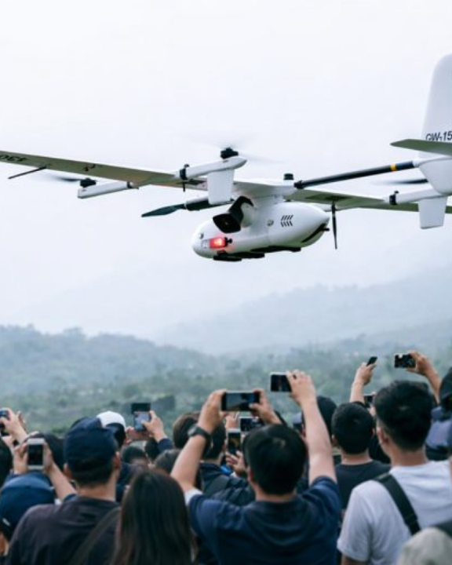

WIDER AREA SURVEILLANCE
CCTV + Drone Fusion AI
Fixed CCTV Tracking
Continuous density counts at gates.
Drone Aerial Intelligence
Monitoring wide outdoor festival grounds.
Unusual Movement Alerts
Detects sudden crowd accumulation.

Slide 6
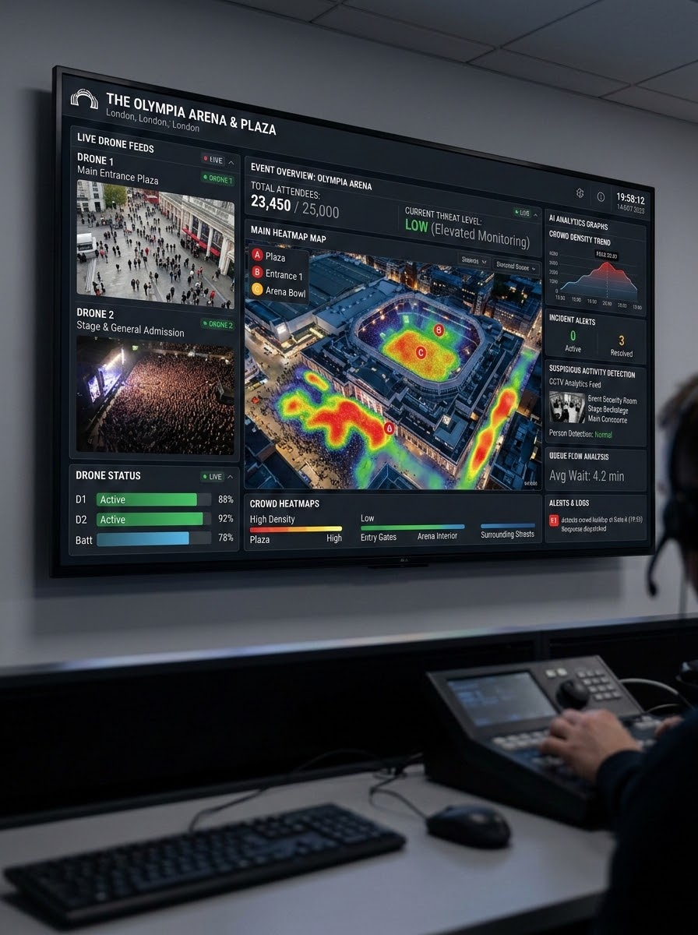
PROPOSED SOLUTION
Centralized AI Platform for Total Event Safety & Control
Automated Attendance
Instantly records attendee entries via QR and secondary biometrics, eliminating gate bottlenecks.
Identity Verification
AI-driven cross-validation ensures seamless credential check-ins and prevents unauthorized access.
Drone & Camera Fusion
Monitors wide outdoor grounds using fixed CCTV and aerial drones to track density live.
Heatmaps & Alerts
Generates dynamic crowd heat maps and automatically dispatches alerts when safety risks arise.

Slide 7
Real-Time Heat Map Risk Zones
Visualizing crowd pressure before it becomes a hazard.
High
Critical
Low
Medium
Precaution Alert
Emergency Response
Normal Level
Monitor Area
Safe continuous flow.
Density slowly increasing.
Congestion forming at gates.
Immediate management required.

Slide 8




Automated Notification Protocols
Crowd Alerts
Security Alerts
Route congestion detected.
Failed identity verification.
Emergency Alerts
Missing Person
Potential stampede indicators.
AI-assisted location tracking.

Slide 9
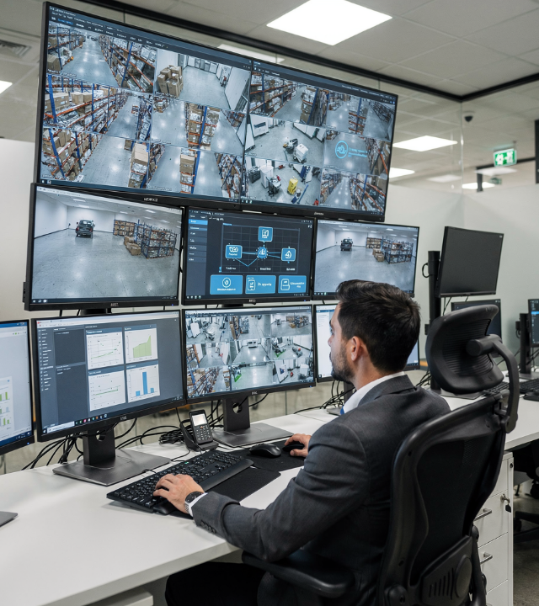
AI-Assisted Missing Person Detection
Locate lost children or vulnerable visitors rapidly using cross-camera AI matching.
Missing Person Report logged.
AI scans all camera feeds.
System flags potential matches.
Security team verifies & responds.

Slide 10

Centralized Control Panel
Administration
Security Operations
Live Registrations
3,000
Density Heat Map
Live
Student Count
2,450
CCTV + Drone Feeds
Active
Guest Passes
370
Risk Alerts
Zero

Slide 11

System Architecture
FRONTEND UI
BACKEND SERVER
HTML, CSS, JS
Python / Flask
Responsive dashboarding.
Secure API routing.
COMPUTER VISION
DATA LAYER
OpenCV + YOLO
PostgreSQL / Firebase
Density analysis modeling.
Live metric sync.

Slide 12


A Single Intelligent Ecosystem
Identity
Data
Analysis
Safety
Verified
Real-Time
Predictive
Proactive Response

Slide 13



EVENTO PLATFORM
evento
Smart Attendance. Smarter Crowd Management. Safer Events.

Slide 14





Image Sources
https://southwestmt.com/blog-content/2026/04/Symphony-Under-the-Stars-Helena-MT-copy-1024x576.png
Source: southwestmt.com
https://img.magnific.com/premium-vector/long-queue-people-customers-line-standing-waiting-crowd-queuing-many-men-women-buyers-entrance-back-view-high-demand-concept-flat-vector-illustration-isolated-white-background_198278-19815.jpg
Source: www.magnific.com
https://www.jouav.com/wp-content/uploads/2026/03/cw-15-flying-over-crowd-768x512.jpg
Source: www.jouav.com
https://visionplatform.ai/wp-content/uploads/2026/01/Control-room-with-AI-annotations-1.png
Source: visionplatform.ai
https://elements-resized.envatousercontent.com/elements-video-cover-images/2cfdcd5e-dbc9-48d4-bc44-933279e04280/video_preview/video_preview_0001.jpg?w=500&cf_fit=cover&q=85&format=auto&s=ce87f00d2e78237214ed420065dbed8cb4c189996d50cdb87c945d6135738317
Source: elements.envato.com

